Slide 1
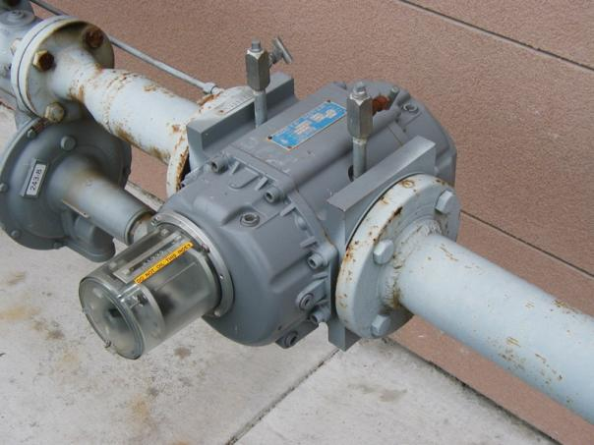
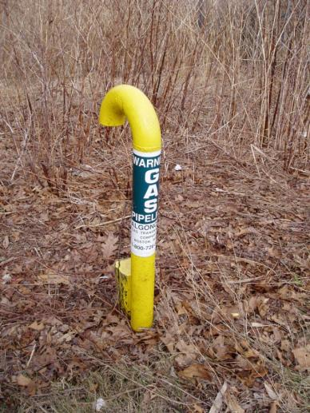
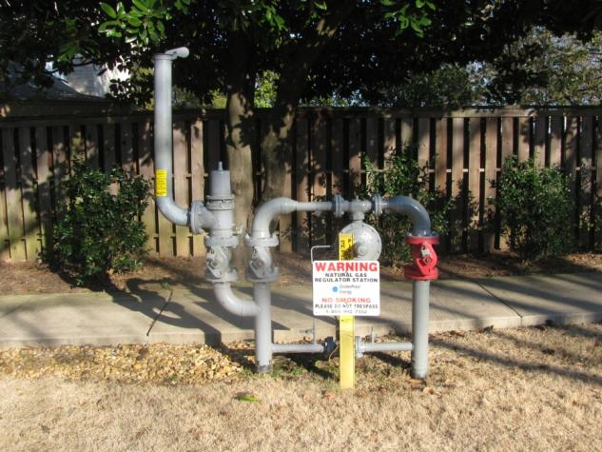
Responding To Natural Gas Emergencies
For more information be sure to read the instructions in the folder before you start.

Slide 2
Chemical & Physical
Properties
Understanding
Natural
Gas
Natural
Gas
Distribution
Natural
Gas
Emergencies
Natural
Gas
Transmission
Can You
Touch This?
100
100
100
100
100
100
200
200
200
200
200
200
300
300
300
300
300
300
400
400
400
400
400
400
500
500
500
500
500
500
Final Jeopardy Question

Slide 3
$100 - Chemical & Physical Properties
LEL or LFL
Answer: Lower Explosive Limit or Lower Flammable Limit

Slide 4
$200 - Chemical & Physical Properties
Rises?
Natural Gas
Falls?
Answer: Rises – natural gas is lighter than air

Slide 5
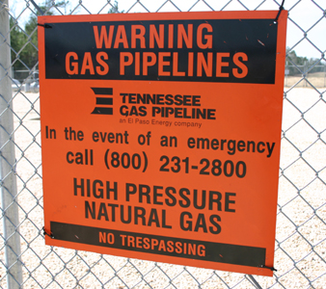
$300 - Chemical & Physical Properties
This characteristic makes the chemical lethal to the respiratory system.
Answer: Asphyxiation or oxygen displacement

Slide 6
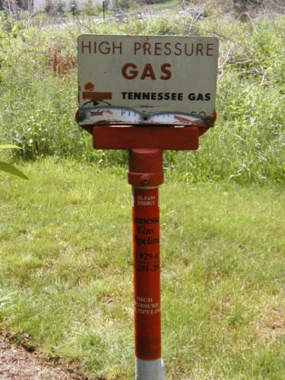
$400 - Chemical & Physical Properties
1100 - 1200 F°
Answer: Natural gas ignition temperature

Slide 7
$500 - Chemical & Physical Properties
If this 0-100% (LEL) meter has been calibrated to natural gas, does the reading indicate an explosion can occur at this exact position?
000
CO
000
H₂S
20.8
O₂
08
LEL
Answer: No – to be flammable, the reading would have to be 100% on the meter not 8%

Slide 8
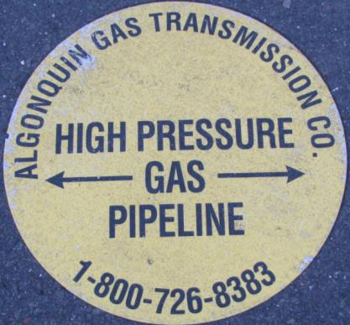
$100 - Understanding Natural Gas
Natural gas requires a minimum mixture of ___________natural gas in air in order to ignite.
Answer: Between 4% to 5% depending on the mixture or operator

Slide 9
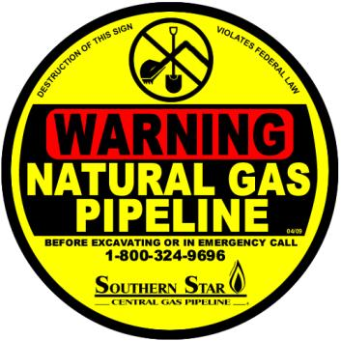
$200 - Understanding Natural Gas
Commercial grade natural gas is usually composed of ethane and butane but the majority of natural gas is ______________.
Answer: Methane

Slide 10
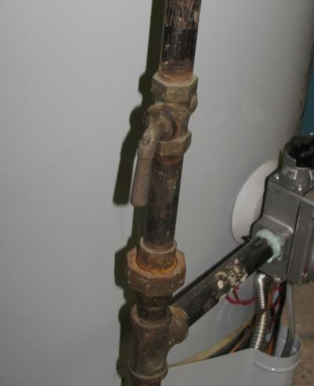
$300 - Understanding Natural Gas
What is this?
Answer: Gas Shutoff to a gas powered appliance

Slide 11
$400 - Understanding Natural Gas
What is this?
Answer: Rotary (“Roots”) gas meter

Slide 12
$500 - Understanding Natural Gas
What is this?... and marker is not enough?
Answer: Casing vent

Slide 13
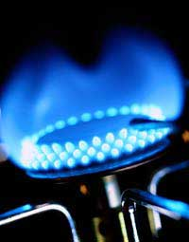
$100 – Natural Gas Distribution
This makes tertiary butyl mercaptan (TBM) or other chemical necessary.
Answer: TBM is an odorant – natural gas is odorless

Slide 14
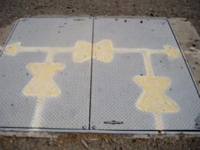
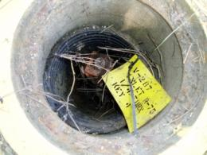
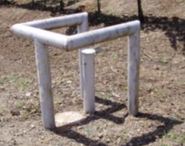
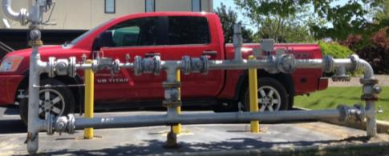
$200 – Natural Gas Distribution
Which of these valves are responders
allowed to turn operate?
A
B
C
D
Answer: None – these are all main valves and are not to
be turned

Slide 15
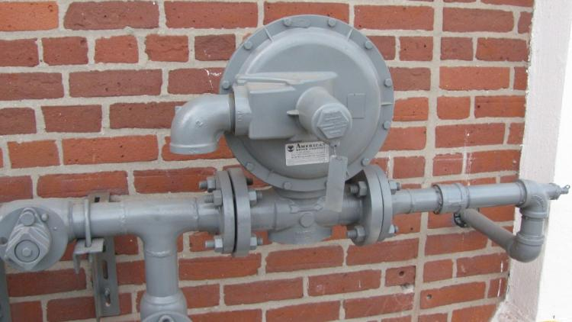
$300 – Natural Gas Distribution
What is this?
Answer: Regulator

Slide 16
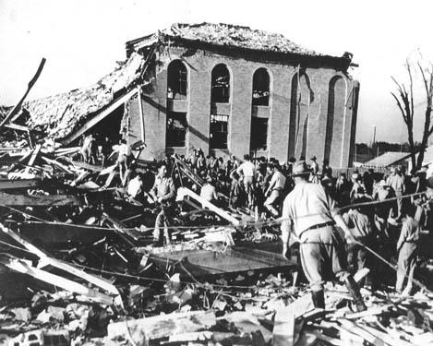
$400 – Natural Gas Distribution
This un-odorized natural gas explosion in central Texas city killed 293 students and faculty lead to odorizing natural gas.
Answer: New London, Texas

Slide 17
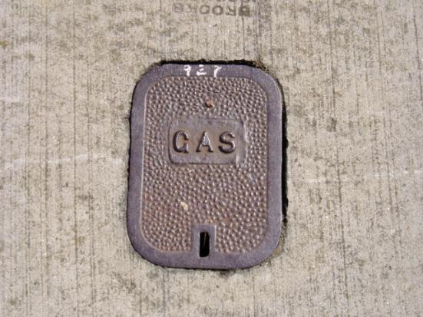
$500 – Natural Gas Distribution
Curb Valve or Main Valve?
Answer: Curb Valve

Slide 18
$100 – Natural Gas Emergencies
This simple warning is critical in preventing emergencies
Answer: “Call Before You Dig”

Slide 19
$200 - Natural Gas Emergencies
The 2012 NA ERG suggested guideline for initial evacuation in a natural gas emergency is:
Answer: 100 meters or 330 feet

Slide 20
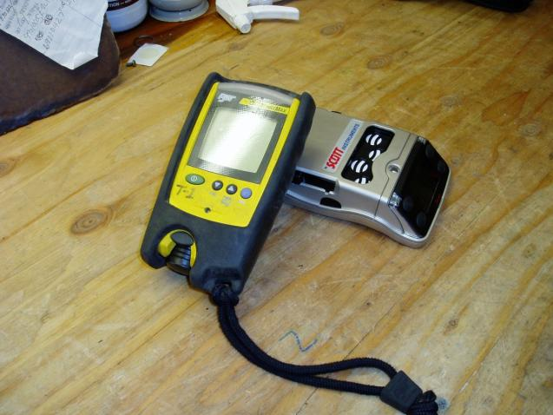
$300 – Natural Gas Emergencies
What is this?
Answer: Combustible Gas Indicator / 4 Gas Meter

Slide 21
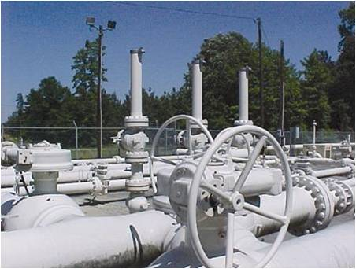
$400 – Natural Gas Emergencies
Closing main valves or other transmission or large distribution valves by responders can result in ...
Answer: Over pressure and/or line failure

Slide 22
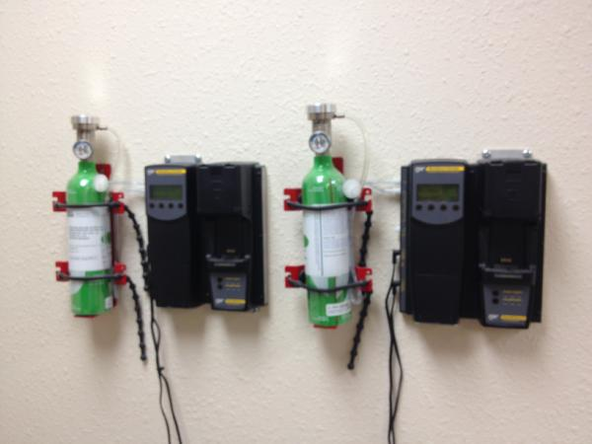
$500 – Natural Gas Emergencies
What is this?
Answer: Calibration site or calibration gas

Slide 23
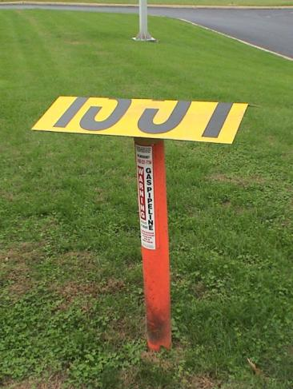
$100 – Natural Gas Transmission
These are used from the air to inspect ___________ for leaks or encroachment.
Answer: ROW or Rights of Way Markers

Slide 24
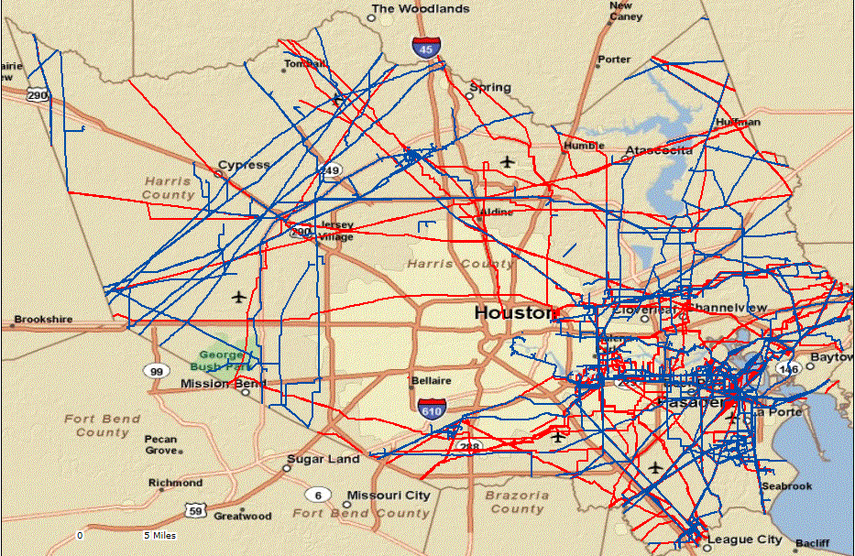
$200 - Natural Gas Transmission
This tool allows any emergency responder to determine if there are pipelines in their county or community
Answer: NPMS - National Pipeline Mapping System

Slide 25
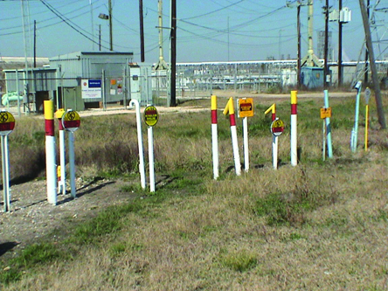
$300 - Natural Gas Transmission
Three critical items of Information you can get from a transmission marker
Answer: Pipeline Operator, Product, 24/7 Phone number

Slide 26
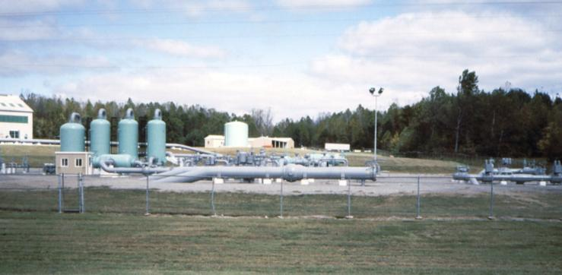
$400 - Natural Gas Transmission
Moving natural gas requires these for increasing the pressure in transmission along the line.
Answer: Compressor Stations

Slide 27
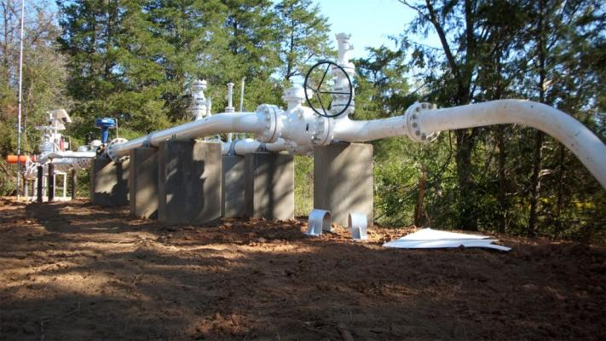
$500 - Natural Gas Transmission
These lines take natural gas from wells to the processing plant and then to transmission lines.
Answer: Gathering Lines

Slide 28
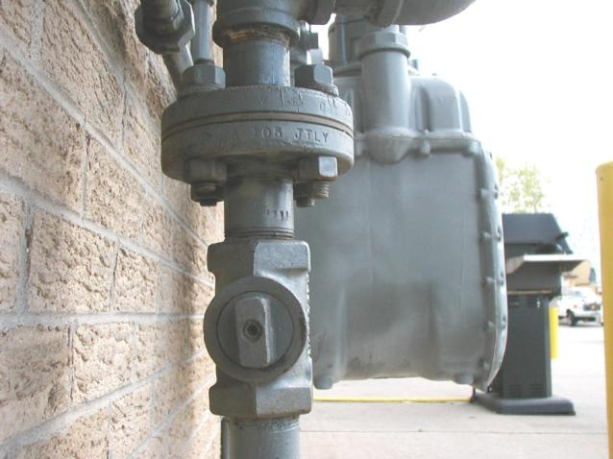
$100 – Can You Touch This?
Answer: Yes, this is a customer service valve

Slide 29
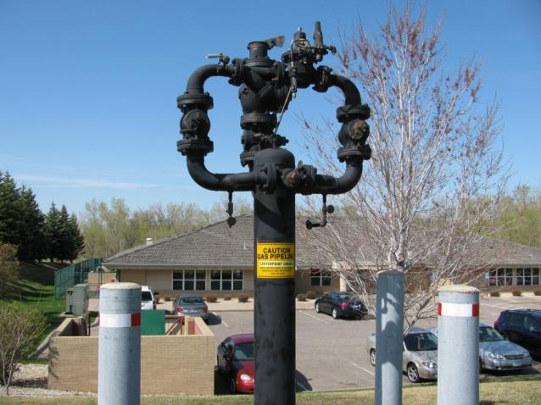
$200 – Can You Touch This?
Answer: No, this is pressure regulator and relief device

Slide 30
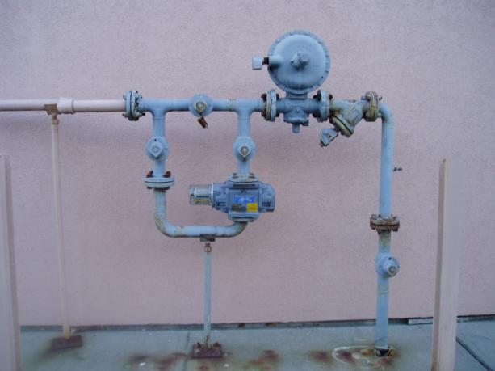
$300 – Can You Touch This?
Answer: Yes, this is a customer service valve

Slide 31
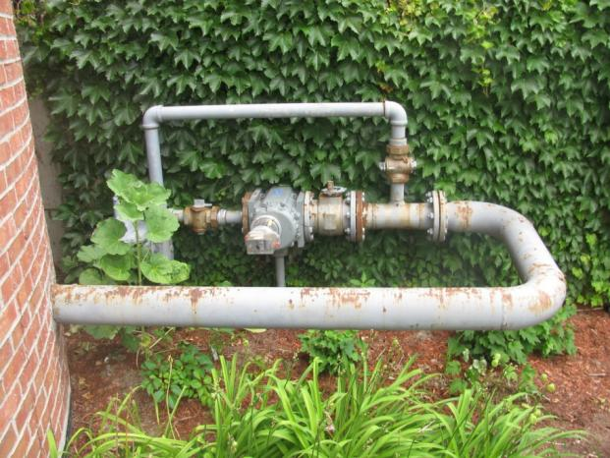
$400 – Can You Touch This?
Answer: Yes, this is a service valve to a large apartment building

Slide 32
$500 – Can You Touch This?
Answer: No, this is a pressure regulator

Slide 33
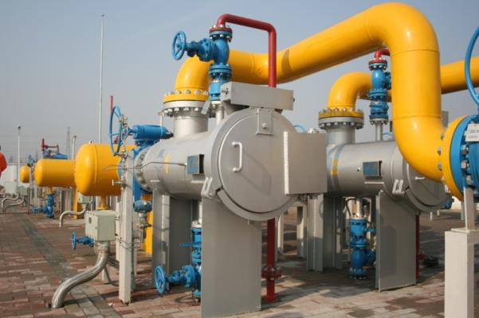
The System
Place Your Wagers
The point in the pipeline system where the finished processed natural gas changes “hands”
Place your wager – when all bets have been recorded click on the button to reveal the question.
START
Answer: Gate Station or Border Station
(Sometimes called “Meter Station” by industry)
Notes:
Answer GATE STATION

